Slide 1

Bank Marketing
Chris Boatto
Justin Carver
Ekaete Czub
Brendan Dagys
Nirali Dave

Slide 2
The Problem: Refining a Marketing Strategy
A Portuguese bank with a telemarketing strategy
Opening long term deposit accounts
Existing data from a previous campaign
Pre-processing, classification, and post-predictive analysis
Identify important factors
Predict future telemarketing targets

Slide 3
R Pre-processing
Imported our data from the .csv file into ‘data’
Determined the classes of the attributes
Isolated the numeric attributes

Slide 4
R Pre-processing
Another ‘for-loop’ to print numeric attributes as well as various descriptive statistics
Histogram
Boxplot

Slide 5
R Pre-processing
Evaluating all outputs provided insight:
Quantity of possible outliers
Mean of values
Variability
Normality

Slide 6
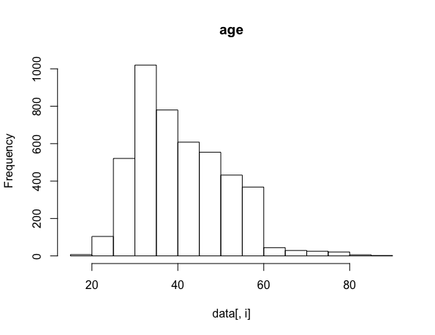
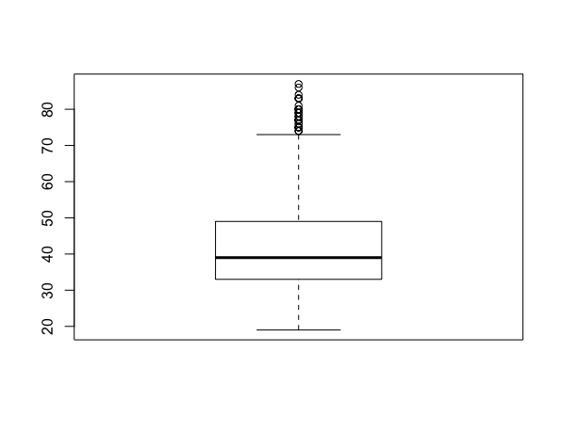
R Pre-processing
Age: Histogram + Boxplot
Notes:
AGE:
Mean: ~40
SD: ~10
Maximum: 80+

Slide 7
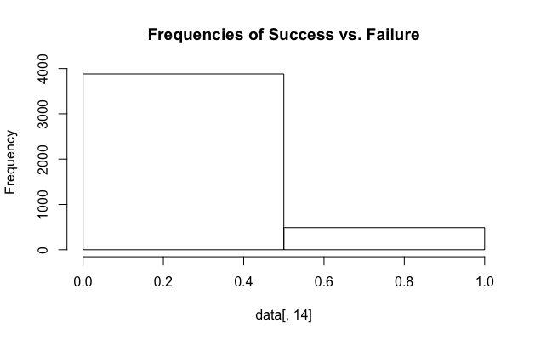
R Pre-processing
Plotted a histogram of the class variable, ‘y’
Frequency distribution of ‘yes’ and ‘no’
VERY IMBALANCED!
Notes:
‘Yes’ value represent those who in the data set who have opened a long term deposit account as a result of the telemarketing campaign
‘No’ value represent those who in the data set did not open a long term deposit account as a result of the campaign

Slide 8
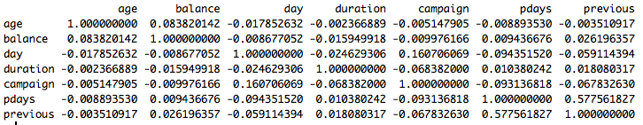
R Pre-processing
Generated a correlation matrix for all numeric attributes to assess dependency on one another
Note: ‘previous’ vs. ‘pdays’
All others around .10 or less
Notes:
Although previous & pdays do not have an overly concerning correlation, it is a notable correlation and was a contributing factor in our decision to remove the variable. All other numeric variables had weak correlations, which permits the use of certain machine learning algorithims

Slide 9
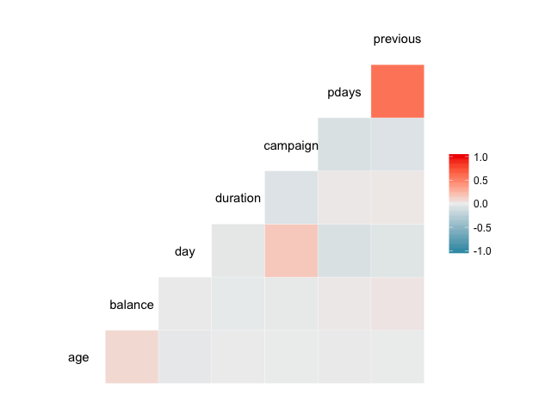
R Pre-processing
ggcorr( )
Notes:
Here is just a graphical indication of correlations, showing once again that the correlation of pdays and previous is the strongest in the dataset

Slide 10
R Pre-processing
Removed attributes that were not helpful:
‘days’
‘pdays’
‘poutcome’
Categorized ‘previous’:
No Contact (0)
Single Contact (1)
Multiple Contacts (2+)
Binned ‘age’: 0-29, 30-39, 40-49, 50-59, 60+
Notes:
After doing initial investigation in R, we played around in Weka. COMING BACK, we removed these attributes for the following reasons:
Days: correlation in Weka to class variable was near zero; no year. Days of week has value, but with no year we couldn’t make sense of it. We believe day could be a useful variable if it could be assigned a day of the week.
Pdays: P days was a measurement for days since last contact, which was a numeric variable. However, with so many people in the data set having never been contacted before, and storing these values as -1 l this variable was deemed to be misleading. Additionally, we determined pdays was a similar metric to ‘previous’ and as a result we removed it and instead adjusted the previous variable to distinguish between levels of previous contact
Poutcome: Poutcome was a measure of the outcome of a previous campaign involving the same person. 80% of observations were unknown, meaning the person had not participated in a previous campaign and thus didn’t have a previous outcome. Furthermore, we decided that the ‘previous’ variable gave us some of the same information. Another issue for this variable was the category of ‘other’, which included about 120 cases. We were unable to determine the semantic meaning of ‘other’

Slide 11
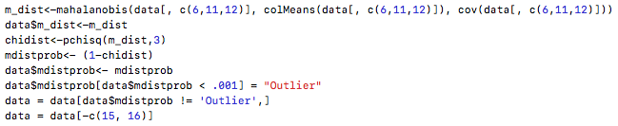
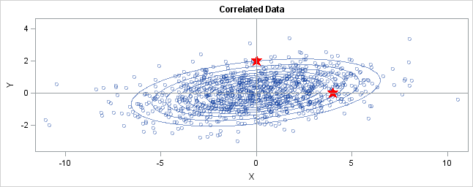
R Pre-processing
Removal of outliers
Mahalanobis distance: using ‘duration’, ‘campaign’, ‘balance’
Advantage to using Mahalanobis distance to determine outliers: formula takes into account differing variances between variables and their covariance
Notes:
-

Slide 12
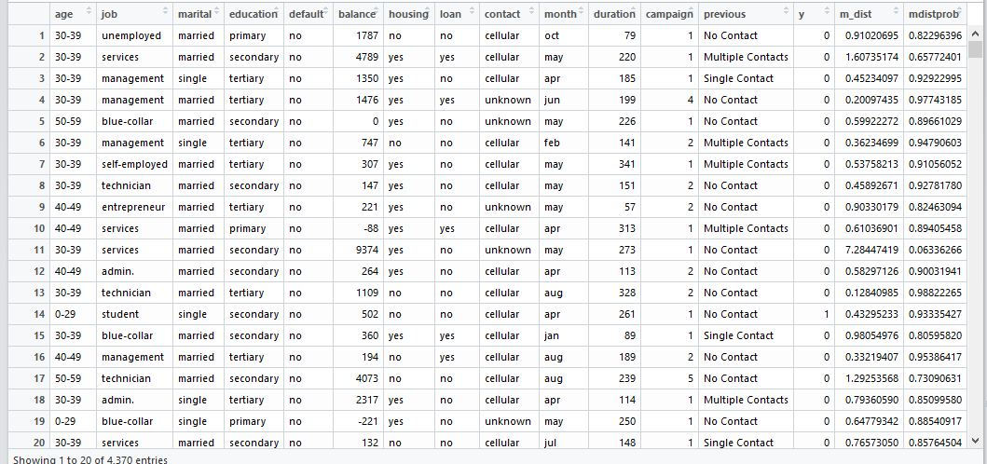
Mahalanobis Distance
Notes:
Mahalanobis distance is calculated for each row and converted to the probability of observing the mahalanobis distance based on the Chi-Sq distribution. Those probabilities that end up being under a certain threshold p-value are considered outliers and removed.
In our case, we set the p-value at 0.001 to limit the amount of outliers removed to ~2.5% of the entire data sat

Slide 13
ZeroR
Usually a good baseline
Output:
Attributes
Number of Instances
Correctly/Incorrectly Classified Instances
Uses ‘0 Rules’ for classification; predicts class value on most common class
All were classified to ‘No’
489 instances were in fact ‘Yes’
Correctly Classified instances: 89%
Notes:
Zero R rep

Slide 14
ZeroR
Was used as a first baseline step because of simplicity
Results do not incorporate the influence of attributes
Notes:
Zero R represents a good baseline for overall prediction when correct prediction of both classes are of equal importance, however for our purposes, we are much more concerned in identifying possible “Yes” candidates than possible ‘No’ candidates

Slide 15
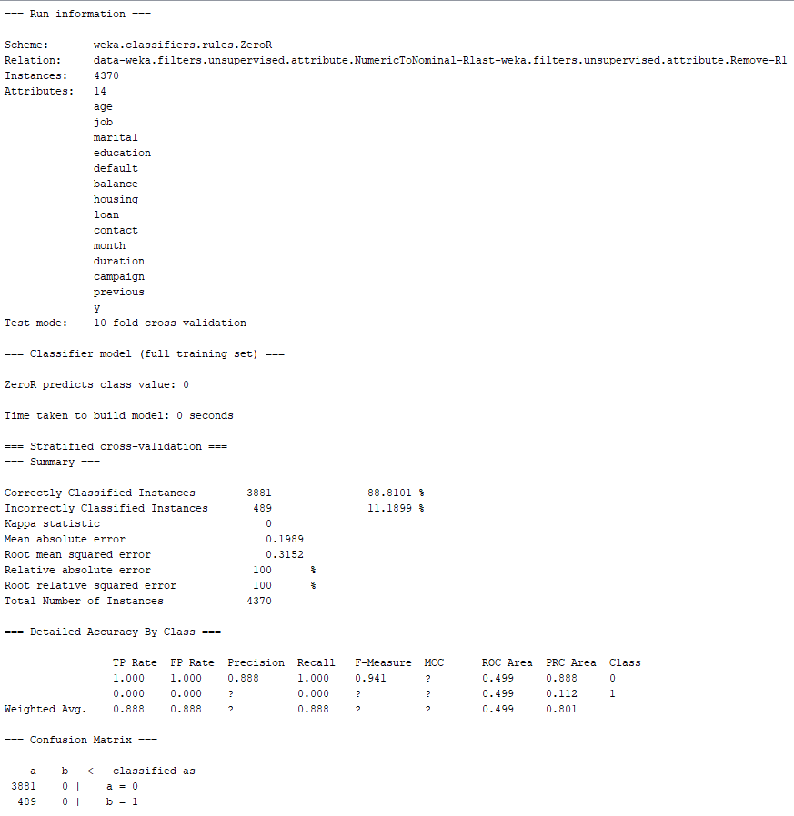
ZeroR
Notes:
- Zero R produces a high amount of correctly identified instances at ~88% due to the fact that in our unbalanced data set there is a very high ration of No’s to Yes’s.

Slide 16
Classification
Goal: To create a model to predict future targets for long term deposit account telemarketing campaigns based on certain attributes
Algorithms used: Naïve Bayes, J48, Logistic Regression
Main focus: Achieving highest possible F-measure and Recall Scores for ‘Yes’ class
Recall (Yes) = True (Yes) + False (No) / All (Yes)
F-measure (Yes): A harmonic mean that balances the precision of ‘Yes’ class with the recall of ‘Yes’ class
Notes:
Overall we will focus on two things in the results of these algorithms, F-measure and Recall scores for the ‘Yes’ class. We decides to focus our efforts on this aspect of the algorithm based on the business problem at hand, identifying possible members of the ‘Yes’ class.
F-measure is a harmonic mean between a classes recall and precision. Achieving the highest possible F-measure for the Yes class variable was one of our main objectives because although we wanted to encourage as much ‘Yes’ class recall as possible, we still wanted to maintain a decent level of precision in our ‘Yes’ class predictions. F-measure gave us a numeric value to measure this.

Slide 17
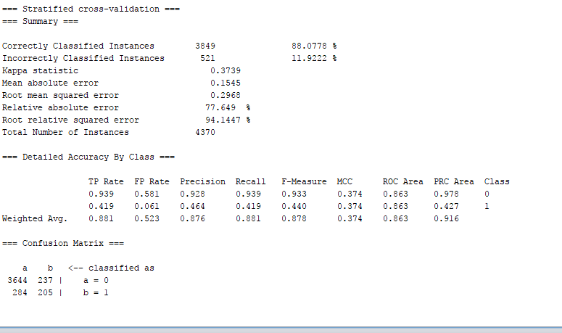
Naïve Bayes
Notes:
88.0778% CCI
At default values, Naïve Bayes outperforms our other chosen classifiers by measure of recall and F-measure value of the ‘yes’ class value

Slide 18
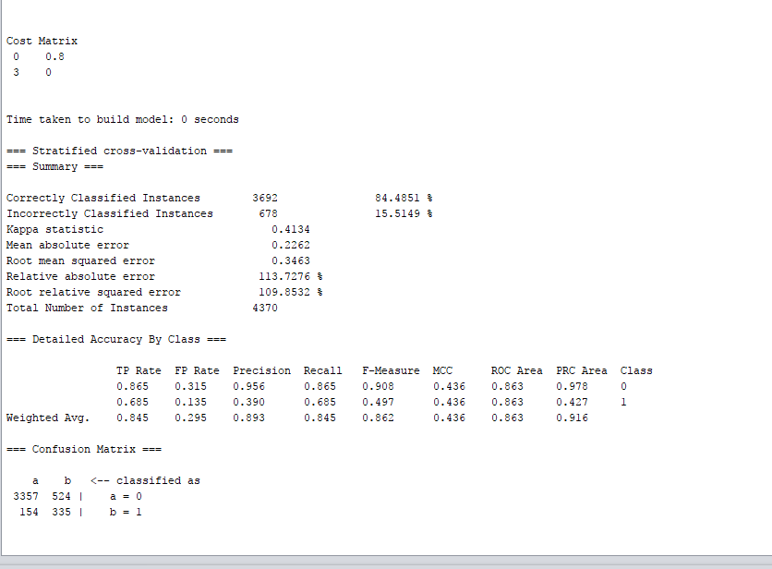
Naïve Bayes
Notes:
Added cost sensitive classifer EXPLAIN!!!, which uses a cost sensitive matrix
A cost-sensitive matrix is a tool that can be used to encourage classification into one category, especially when there is a large imbalance between classes and one class is of more concern than the other. In our case, we were willing to sacrifice overall accuracy of our model in order to identify possible ‘Yes’ respondents.
We accomplished this by implanting a cost matrix which punished False No’s (Yes observations that were incorrectly classified as ‘No’) and therefore would lead to a higher ‘Yes’ recall. The weighted values in the above cost matrix were manipulated till the highest ‘Yes’ class F-measure was obtained.
Correctly classified instances decreases, but is less important than F measure for our purposes
Recall values (and more importantly F-measure) increase, however (0.440 to 0.497 [F])
Recall increased over 50%

Slide 19
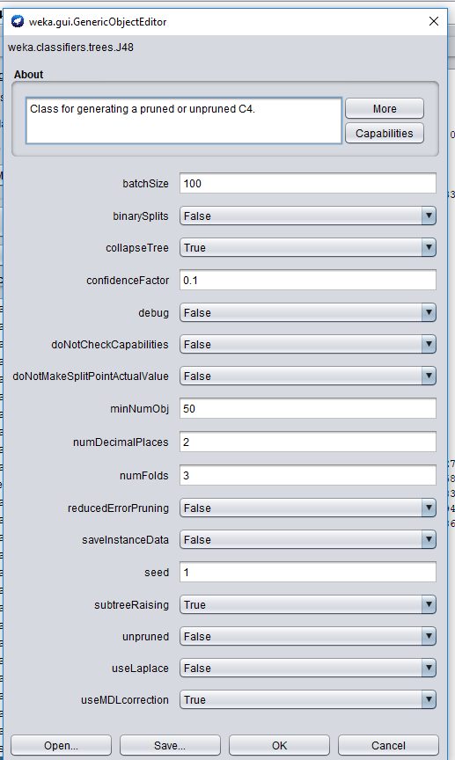
Decision Tree
Notes:
We adjusted confidence intervals and minimum number of objects in order to avoid over-fitting of the tree.
Default confidence level for J48 is set at .25, but we decreased it to .1. Additionally, default value for minimum objects is 2, but we increased it to 50.
These adjustments helped avoid over-fitting and reduce the size of the tree to a more manageable size

Slide 20
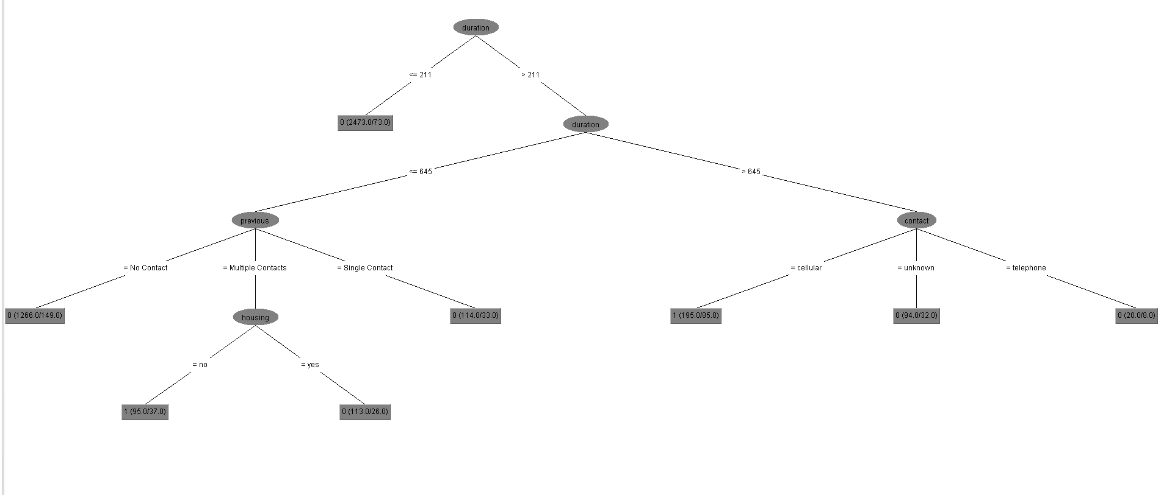
Decision Tree

Slide 21
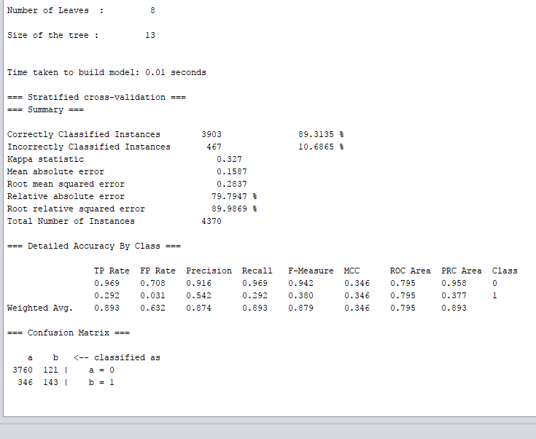
Decision Tree

Slide 22
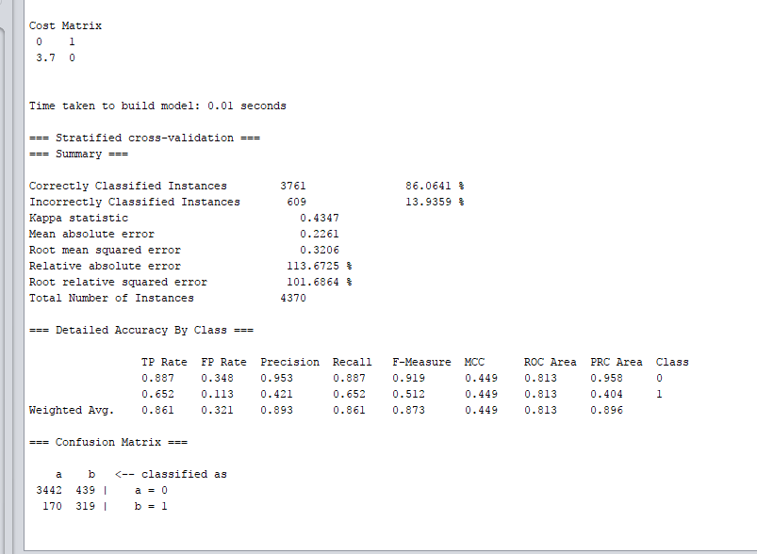
Decision Tree
Notes:
With cost matrix, recall and F-measure improve for the ‘y’ class, however overall accuracy diminishes and the tree grows in size

Slide 23
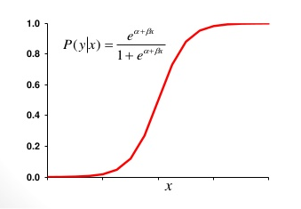
Logistic Regression

Slide 24
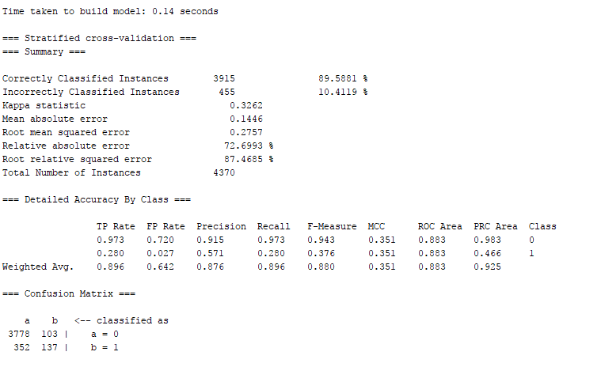
Logistic Regression
Notes:
WITHOUT COST MATRIX adjustment
Same problem as other classifiers without cost matrix:
overall good accuracy, but poor results in recall and F-measure for ‘y’ class

Slide 25
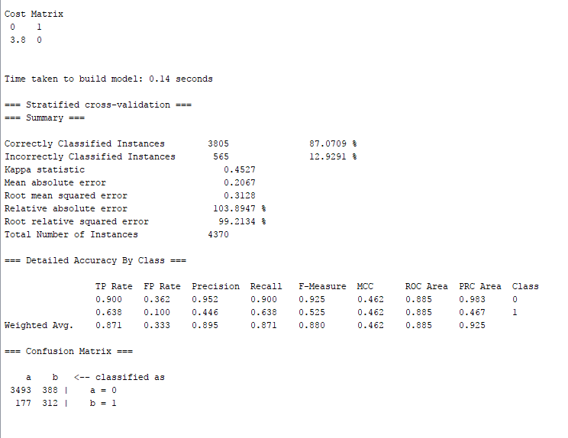
Logistic Regression
Notes:
WITH COST MATRIX
F-measure of 0.525 is the best of any classifier with a very strong recall value to accompany it at 0.638
Utilizing the cost matrix, accompanied by use of the logistic regression algorithm, gives the bank the best chance of identifying potential long term investors based on each individual’s attributes

Slide 26
Association Rules
Applied a filter: numeric to nominal
Apriori algorithm requirement
First run was with default settings:

Slide 27
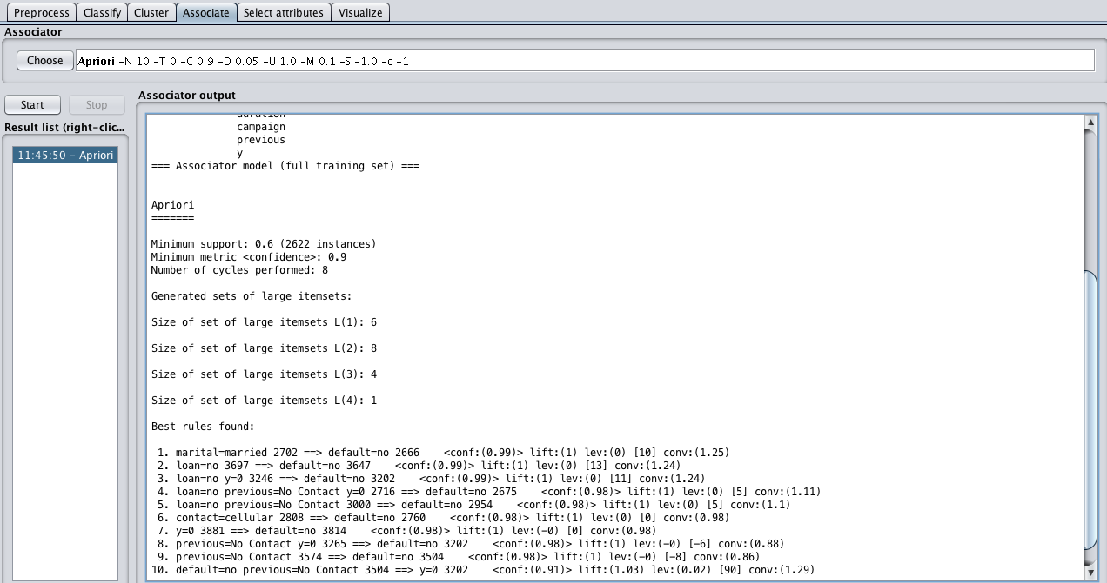
Association Rules
Notes:
10 rules
No predictions for the class value
All rules contained ‘contact’ or ‘default’
High high confidence values

Slide 28
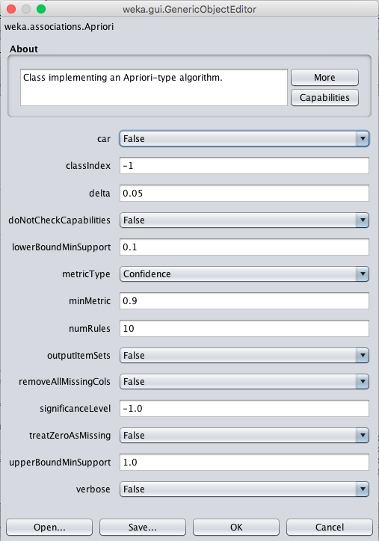
Association Rules
Notes:
Car = False
Confidence = 0.9
Numrules = 10

Slide 29
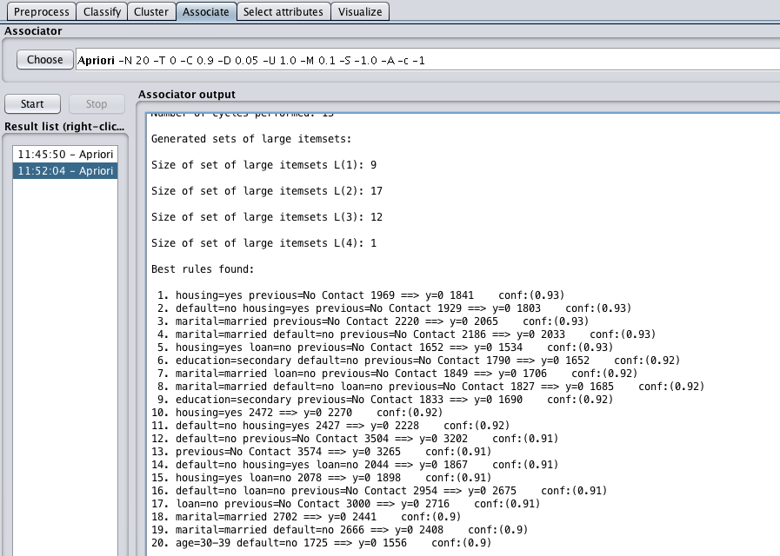
Association Rules
Notes:
This generated lower, more realistic confidence (~0.90)
More variety
New goals: more variety, predictions of ‘yes’

Slide 30
Association Rules
Tweaked more settings:
Increased minimum support from 0.1 to 0.5
NO SIGNIFICANT CHANGE
Decreased minimum confidence from 0.9 to 0.65
NO SIGNIFICANT CHANGE
Same confidence value
Not a single ‘yes’ on right side
Notes:
- It’s hard to find rules in an unbalanced dataset like this one because the support for all rules of ‘yes’ will be extremely low based on the nature of the class variable

Slide 31
Association Rules
Experimented:
Removed some combinations of attributes to manipulate rule contents
Some more alterations of algorithm settings
Ultimately, couldn’t get rules that led to a class value of ‘yes’
Very large amount of ‘no’ values (ratio 3881:489)

Slide 32
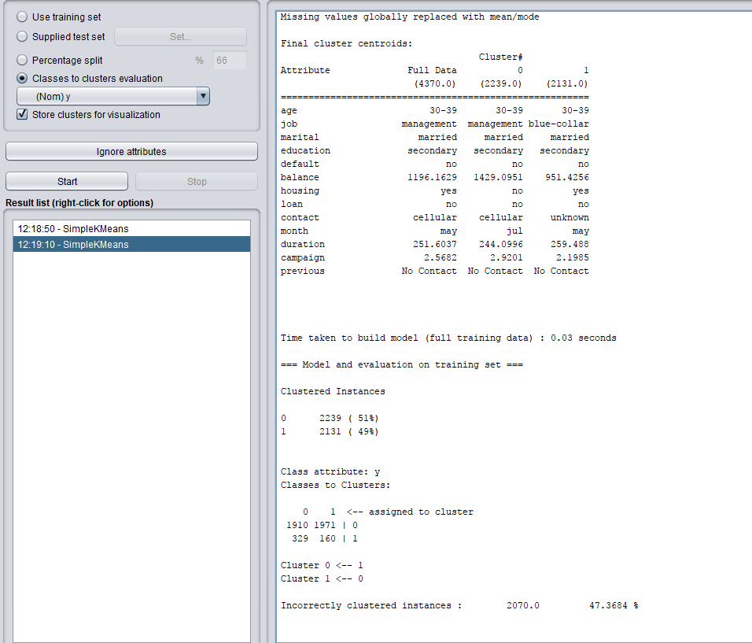
Clustering
Notes:
Before running K-means Clustering, we made sure to utilize the ‘Classes to clusters function’ in order to identify possible profile attributes for the ‘Yes’ and ‘No’ classes.
Overall, Clustering performs very poorly as a means to identify potential long-term deposit account clients.
There is only ~50% accuracy overall in identification of each class, with a recall value in the 30% percent range for the ‘Yes’ class. Both of these are very discouraging scores.
Some inferences could possibly be made through acknowledging a lower mean balance for the ‘Yes’ cluster, as well as a longer mean duration for the ‘Yes’ cluster.

Slide 33
Wrapping Up
Unbalanced data set caused problems
Unsupervised training methods (Association and Clustering) offered little information
Cost sensitive matrix : Key in dealing with unbalanced classes
Logistic Regression offers us the most predictive power in terms of ‘Yes’ class

Slide 34
Going Forward
Still room for improvement
Correct identification
Increase profit
Minimize wasted resources
Options:
Different combinations of variables
Added variables
New algorithms
Also, can we please get some days of the week!?!?!?!?
Notes:
Even our best model still leaves some room for improvement
Correctly identifying targets for telemarketing while minimizing wasted calls remains the main predictive goal of our data analysis
Looking into different combinations of variables to include in analysis, adding more variables to data set and looking into different classification algorithms are all areas that could be further examined in future research
Also can we please get some days of the week!?!?!?!?

